Slide 1
CS3391 Object Oriented Programming
Dr.D.Sivaganesan, Professor,
PSGiTech / CSE

Slide 2
INHERITANCE
Inheritance can be defined as the procedure or mechanism of acquiring all the properties and behaviors of one class to another, i.e., acquiring the properties and behavior of child class from the parent class.
When one object acquires all the properties and behaviors' of another object, it is known as inheritance. Inheritance represents the IS-A relationship, also known as parent-child relationship.
Uses of inheritance in java
For Code Reusability.
For Method Overriding (so runtime polymorphism can be achieved).
Types of inheritance in java:
single, multilevel and hierarchical inheritance. Multiple and hybrid inheritance is supported through interface only.
Syntax:
class subClass extends superClass
{
//methods and fields
}

Slide 3
Terms used in Inheritance
Class: A class is a group of objects which have common properties. It is a template or blueprint from which objects are created.
Sub Class/Child Class: Subclass is a class which inherits the other class. It is also called a derived class, extended class, or child class. It can created using keyword extends .
Super Class/Parent Class: Super class is the class from where a subclass inherits the features. It is also called a base class or a parent class.
Reusability: As the name specifies, reusability is a mechanism which facilitates you to reuse the fields and methods of the existing class when you create a new class. You can use the same fields and methods already defined in previous class.

Slide 4
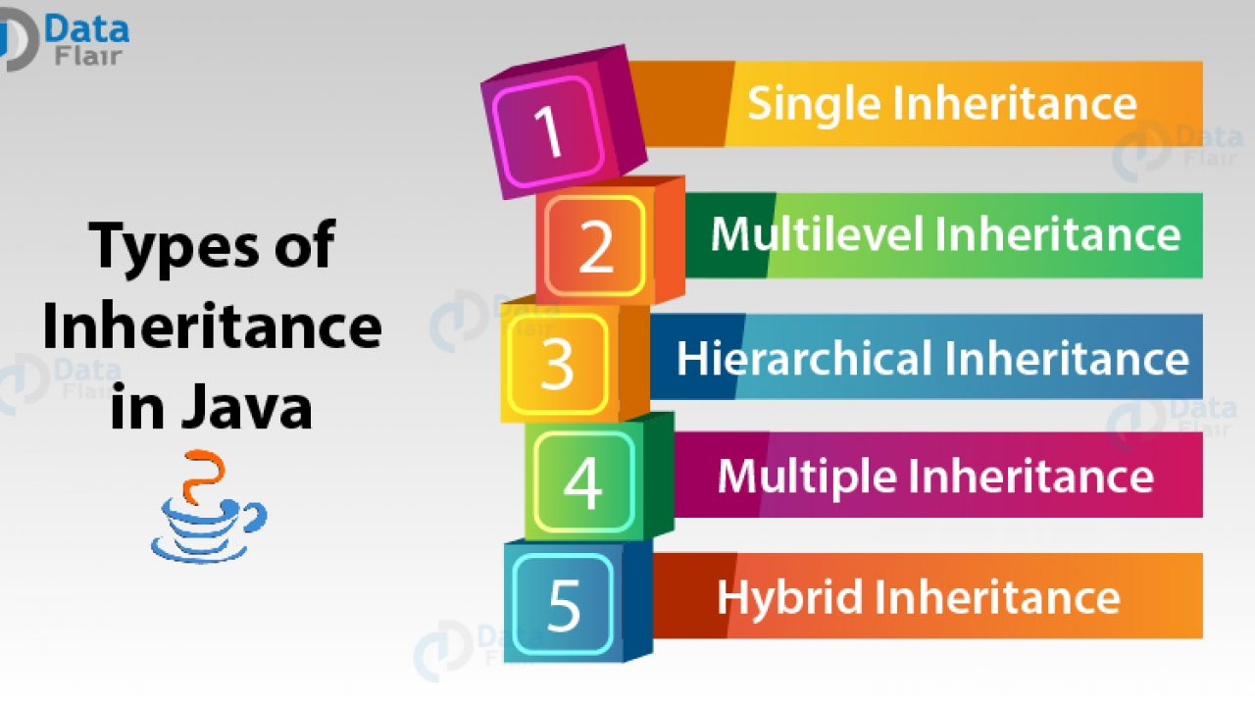

Slide 5
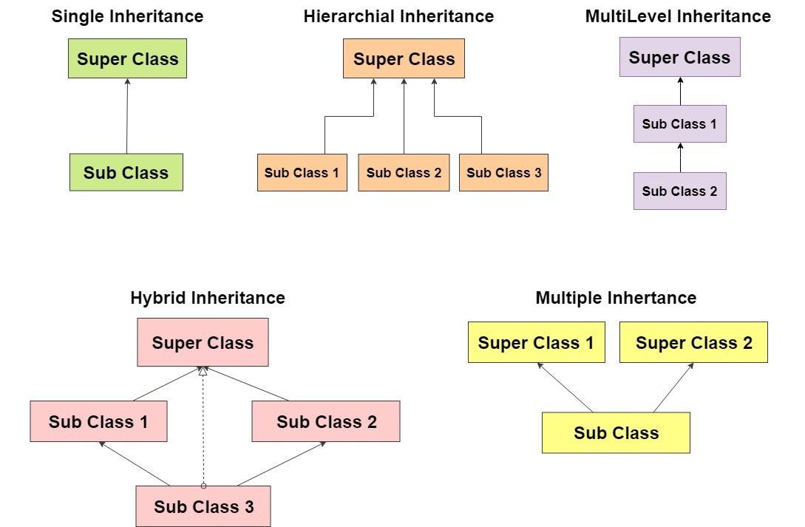

Slide 6
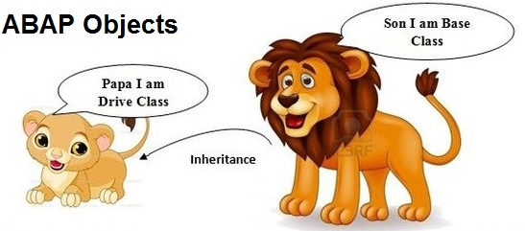
Single Inheritance

Slide 7
SINGLE INHERITANCE
In Single Inheritance one class extends another class (one class only).
Example:
class ClassA
{ public void dispA()
{ System.out.println("disp() method of ClassA");
} }
public class ClassB extends ClassA // child class classB from parent class classA
{
public void dispB()
{ System.out.println("disp() method of ClassB"); }
public static void main(String args[])
{
//Assigning ClassB object to ClassB reference
ClassB b = new ClassB();
//call dispA() method of ClassA
b.dispA();
//call dispB() method of ClassB
b.dispB(); } }
Output :
disp() method of ClassA
disp() method of ClassB

Slide 8

Multilevel Inheritance

Slide 9
MULTILEVEL INHERITANCE
In Multilevel Inheritance, one class can inherit from a derived class. Hence, the derived class becomes the base class for the new class.
Example:
class ClassA
{ public void dispA()
{ System.out.println("disp() method of ClassA"); }
}
class ClassB extends ClassA
{ public void dispB() {
System.out.println("disp() method of ClassB"); }
}
public class ClassC extends ClassB
{ public void dispC() {
System.out.println("disp() method of ClassC");
}
public static void main(String args[])
{
//Assigning ClassC object to ClassC reference
ClassC c = new ClassC();
//call dispA() method of ClassA
c.dispA();
//call dispB() method of ClassB
c.dispB();
//call dispC() method of ClassC
c.dispC();
} }

Slide 10
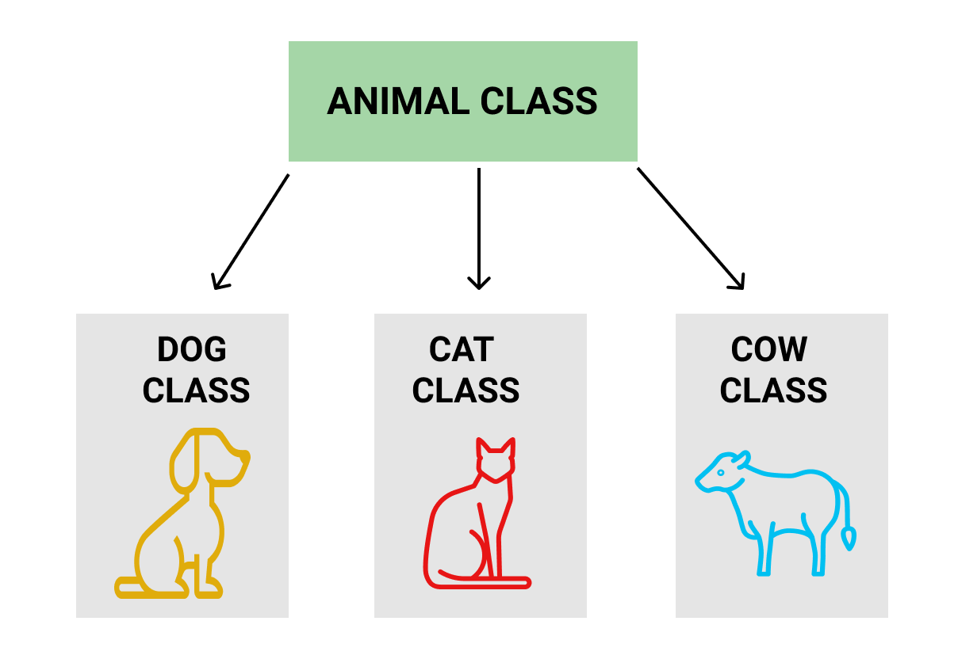
HIERARCHICAL INHERITANCE

Slide 11
HIERARCHICAL INHERITANCE
In Hierarchical Inheritance, one class is inherited by many sub classes.
Example:
class ClassA
{ public void dispA()
{ System.out.println("disp() method of ClassA");
} }
class ClassB extends ClassA
{ public void dispB() {
System.out.println("disp() method of ClassB"); } }
class ClassC extends ClassA
{ public void dispC() {
System.out.println("disp() method of ClassC"); }}
class ClassD extends ClassA
{ public void dispD() {
System.out.println("disp() method of ClassD"); }}
public class HierarchicalInheritanceTest
{ public static void main(String args[]) {
//Assigning ClassB object to ClassB reference
ClassB b = new ClassB();
//call dispB() method of ClassB
b.dispB();
//call dispA() method of ClassA
b.dispA();
//Assigning ClassC object to ClassC reference ClassC c = new ClassC();
//call dispC() method of ClassC
c.dispC();
//call dispA() method of ClassA
c.dispA();
//Assigning ClassD object to ClassD reference
ClassD d = new ClassD();
//call dispD() method of ClassD
d.dispD();
//call dispA() method of ClassA
d.dispA();
}
}

Slide 12
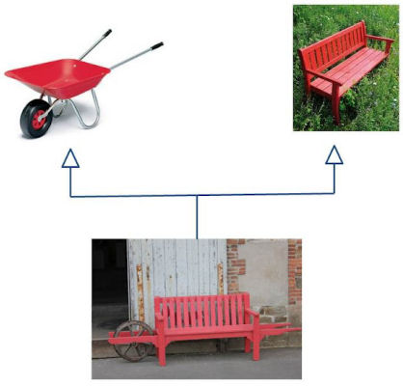
Multiple Inheritance

Slide 13
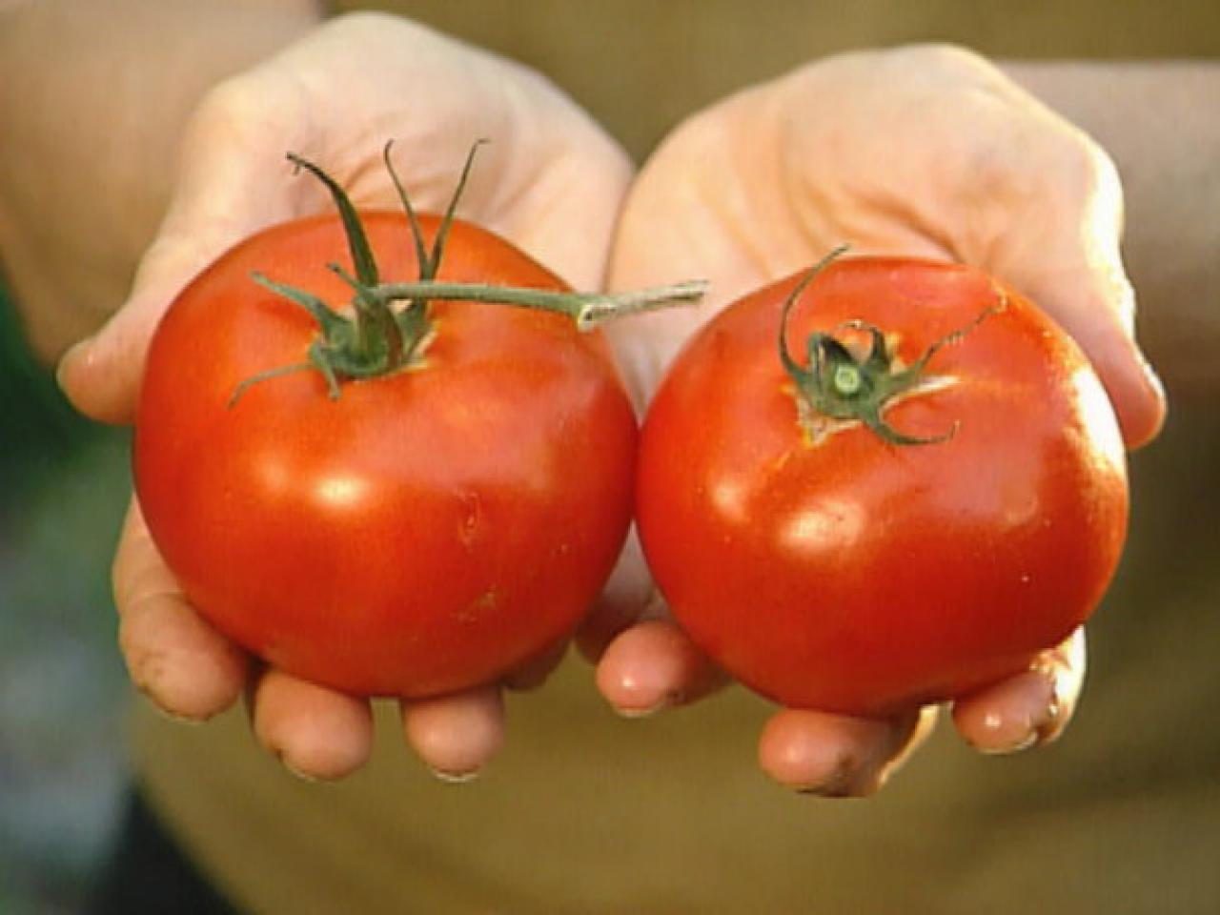

Hybrid Inheritance

Slide 14
Thank you

